Slide 1
BUSINESS ANALYTICS CASE STUDY
OMODOLAPO OLADOKUN
MICROSOFT EXCEL

Slide 2
Business Problem
Customer Churn reduces recurring revenue amd profitability
Why are customers leaving?
Who is most likely to churn
What business factors influence churn?
How can churn be reduced?

Slide 3
Dataset Overview
Industry: Telecommunications
Rows: 7,043
Columns: 21
Target Variable: Churn
21 customer, service and billing variables

Slide 4
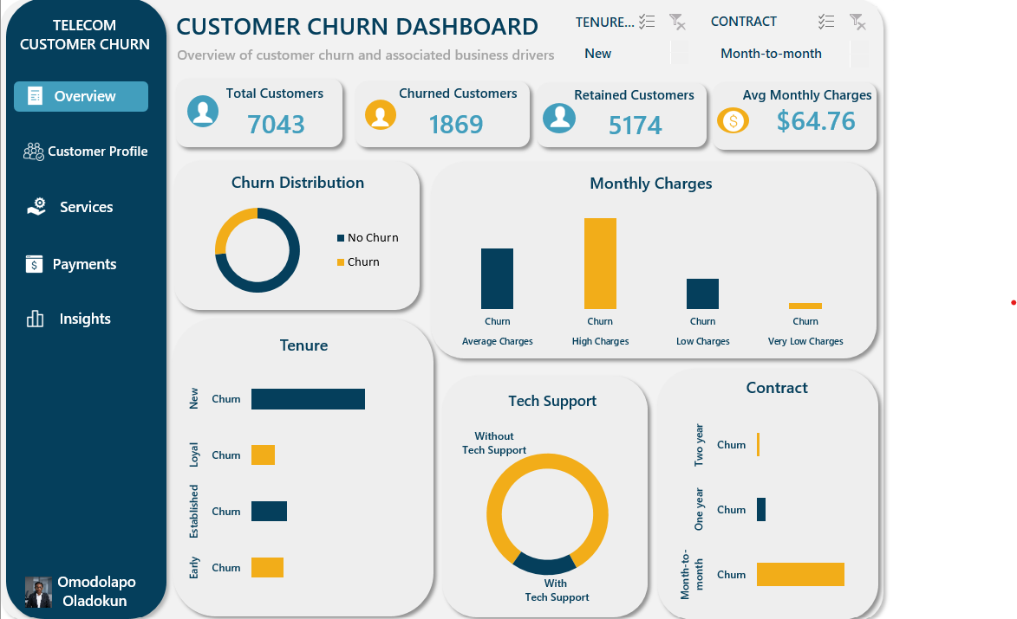
Dashboard Overview

Slide 5
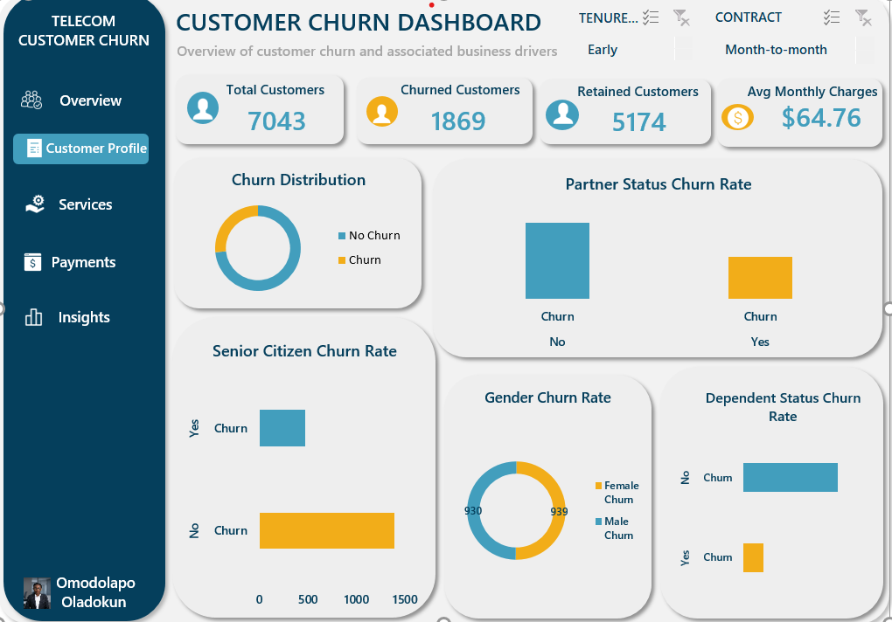
Customer Profile Dashboard

Slide 6
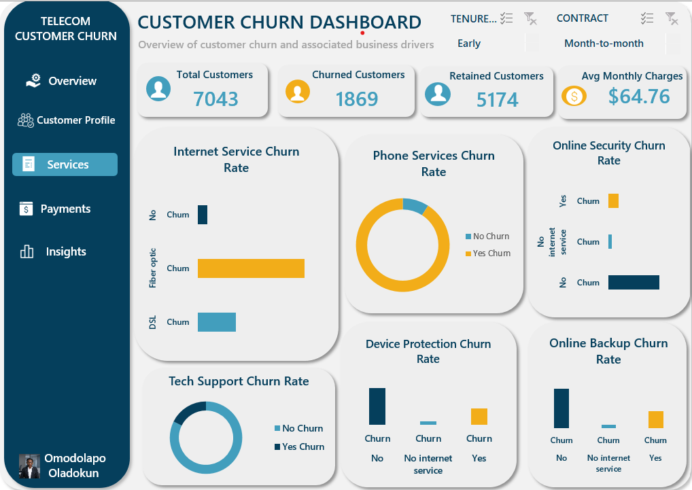
Services Dashboard

Slide 7
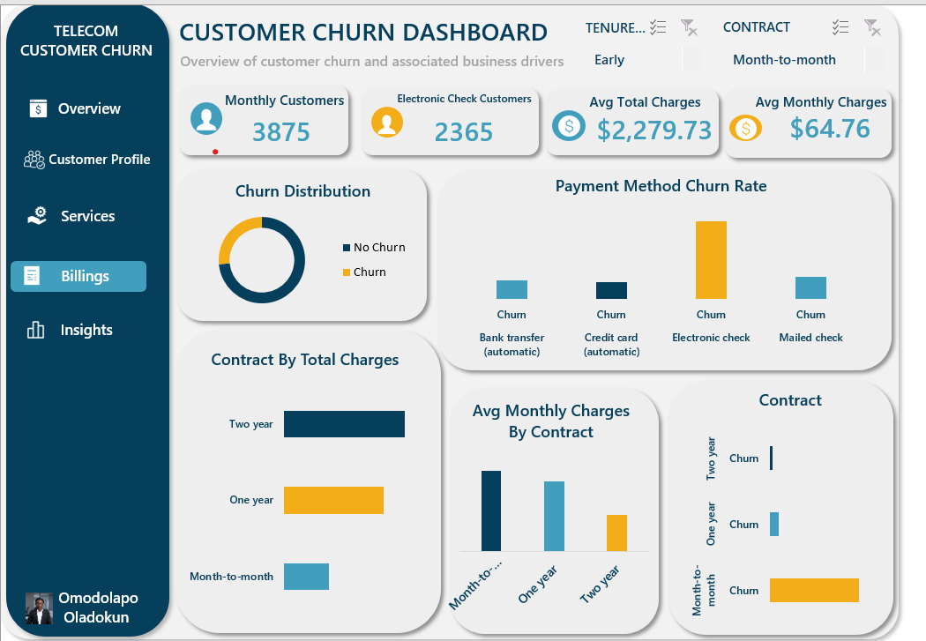
Billing Dashboard

Slide 8
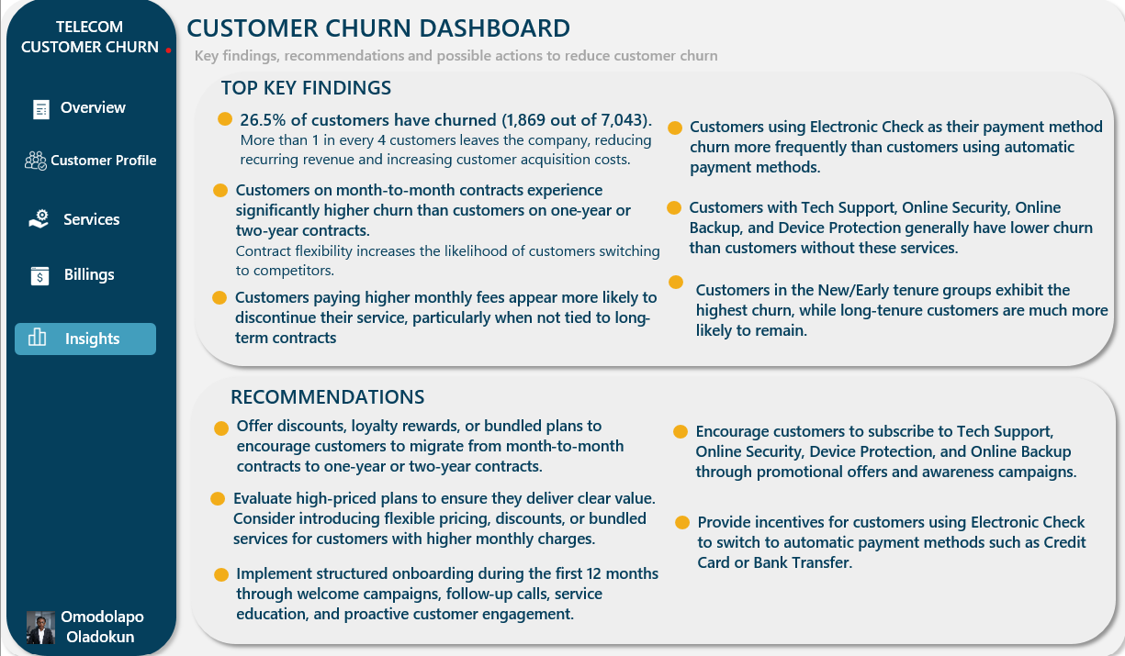
Insights and Recommendations

Slide 9
THANK YOU

